Slide 1
Congestion Charging in London
ROAD PRICING TO REDUCE EMISSIONS CASE STUDY
GROUP #4

Slide 2
Business Problem
How to exploit the WTP to ensure reduction in congestion within the charging zone and reduction of CO2?
Minimize the number of cars entering the zone during the 7am-6pm while satisfying the 500,000 daily operating cost.

Slide 3
Given Information
Levy Cost £8 per day
Time 7am and 6pm on weekdays (11 hours)
Peak hours are between 7:00am – 9:00am and 4:00pm – 6:00pm (4 hours)
Different WTP for peak and off-peak periods
Total Population is 192,000 Cars
Daily Operating Costs are £500,000
Negative relationship between the number of cars entering the charging zone and the average speed in km/h. [Average Speed=30 -0.0625 x (Thousand Cars)]
Average CO_2 emissions per can be estimated using the following relationship between speed (in km/h) and CO_2 emissions in g/km
◦If speed < 25〖CO〗_2 Emissions = 616.6 – 16.7 x Speed
◦If speed > 25〖CO〗_2 Emissions = 235.7 – 1.4 x Speed

Slide 4
Assumptions
We don’t have average CO2 levels
We don’t have the average speeds

Slide 5
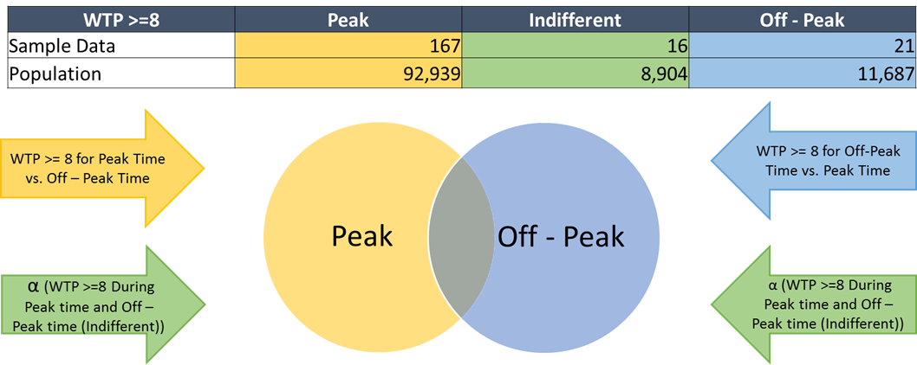
Baseline – Levy Cost £8 per day

Slide 6
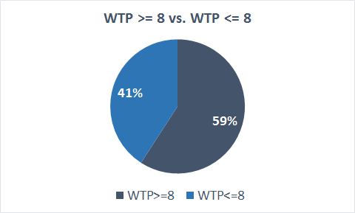
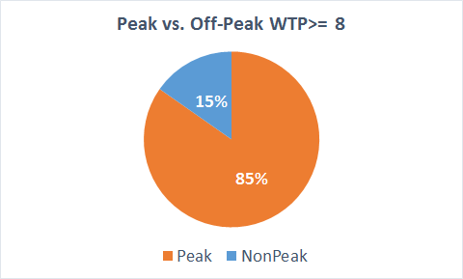
Baseline – Levy Cost £8 per day

Slide 7
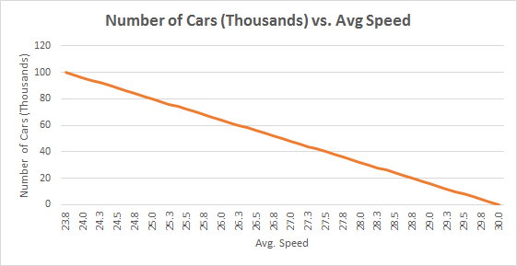
Baseline – Levy Cost £8 per day
Avg. Speed at Peak time is 28.50 km/h
Avg. Speed at Off Peak is 29.85 km/h
Avg. Speed at the Zone is 29.35 km/h

Slide 8
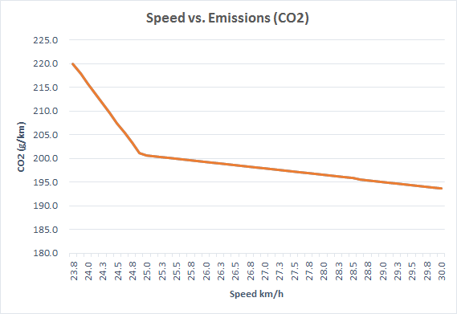
Baseline – Levy Cost £8 per day
Avg. CO2 at Peak time is 196 g/km
Avg. CO2 at Off Peak is 194 g/km
Avg. CO2 at the Zone is 195 g/km

Slide 9
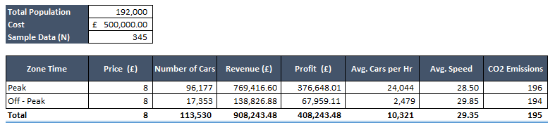
Baseline – Levy Cost £8 per day
It is a simplistic method to determine the price which meets the constraints of £500,000 operational cost
Does not solve the business problem

Slide 10
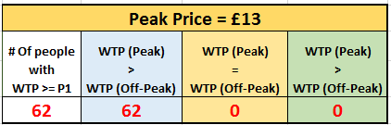
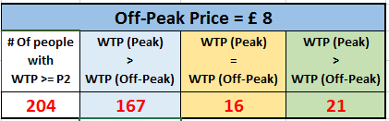

Differential Pricing Models – Car Distribution
1
2
3
4
5
6
 | (Total – Leisure Travelers)
 | Half of Leisure Travelers (0.505/2)
 | = 6/11
 | = 5/11
 | ALL
 | Total Off-peak people
1
2
3
4
5
6

Slide 11
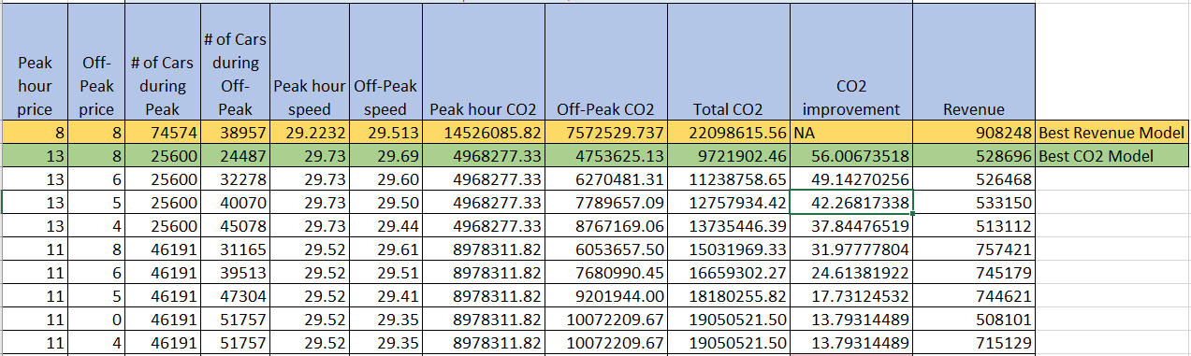
Differential Pricing – Best Models

Slide 12
Justification for Previous Model

Slide 13
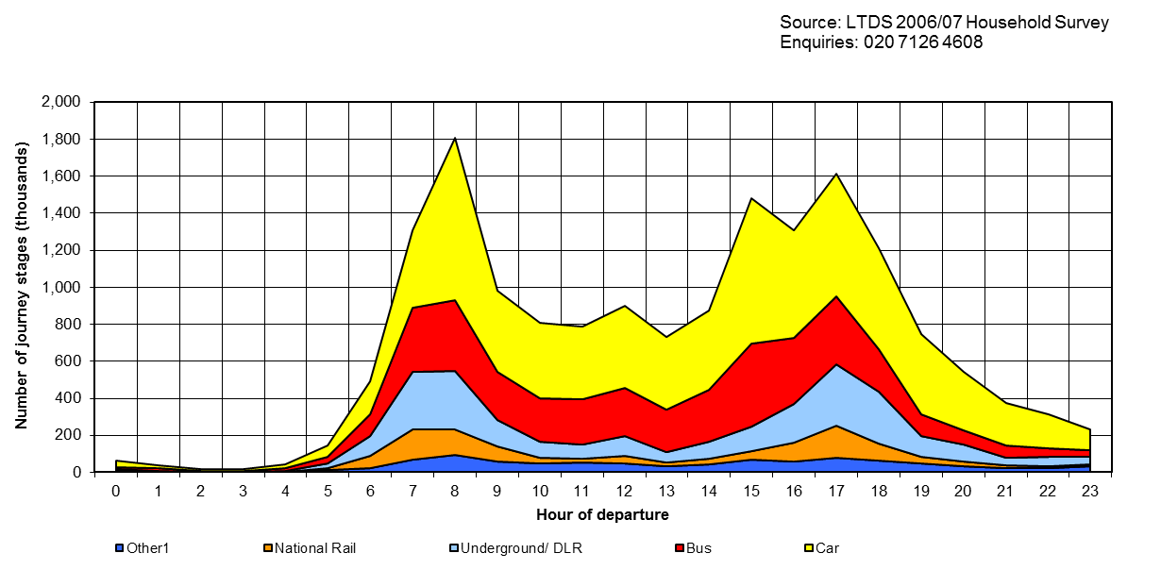
Car Arrival Rates

Slide 14
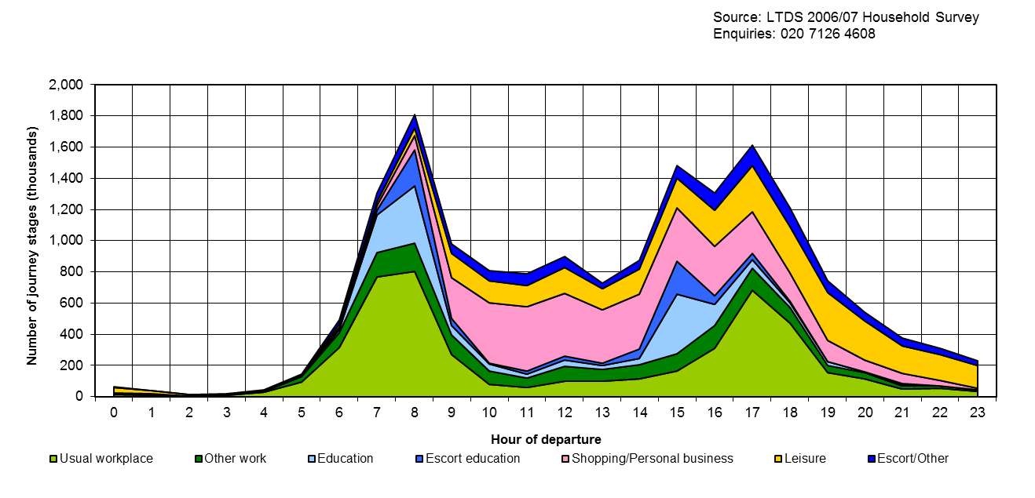
Arrival Rates Based On Customer Segments

Slide 15
Summary of Proposed Model
Total number of cars | 192,000
Average speed(peak hrs) | 28.86
Average speed(off peak hrs) | 28.97
CO2 emissions(peak hours)-gm/km | 21,434,762.97
CO2 emissions(off peak hours) | 16,059,772.22
CO2 emissions (total) | 37,494,535.20
Speed Improvement in peak | 0.15
Reduction in CO2 Emission in peak | 2,827,805.10
Overall CO2 Emission reduction | 17,431.85

Slide 16
Qualitative Suggestions
Move business hours of businesses that are customer-facing to off-peak hours
Move businesses to non-congestion areas by providing incentives like providing facilities at discounted prices
Shift regular working office hours to off-peak hours
Provide incentives to companies/businesses who are encouraging car-pooling or bus-pooling and penalize by charging higher prices for the companies that don't comply
Improve infrastructure for cyclists

Slide 17
Qualitative Suggestions
Higher congestion charge for older vehicles
Targeted car reduction for each of the companies/businesses
Reduce the public transportation costs
Variable parking prices w.r.t. time and location
Congestion charge proportional to the size of the car and CO2 emission per person
Add specific entry/exit points for specific zones within the congestion zone
Change peak hour timings from 7:00am to 10:00am and 3:00pm to 6:00pm (based on data)

Slide 18
London Congestion Charge – Today!
Current Charge – 11.5 pounds/day
Enforcement - ANPR
Variable Pricing – when do you pay?
Revenue from Congestion Charge - invested in improving public transport and infrastructure.
Discounts – Resident’s discount zone, 9+ seaters, ULED (<75g/Km), motor tricycles, Electric Vehicles
Exemptions – Embassies, Public Sector Organizations
Electric Bus Revolution

Slide 19
Thank You

